Slide 1
Time Series: UNIT 3
Live Session

Slide 2
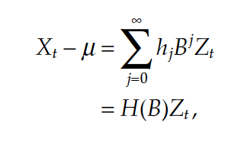
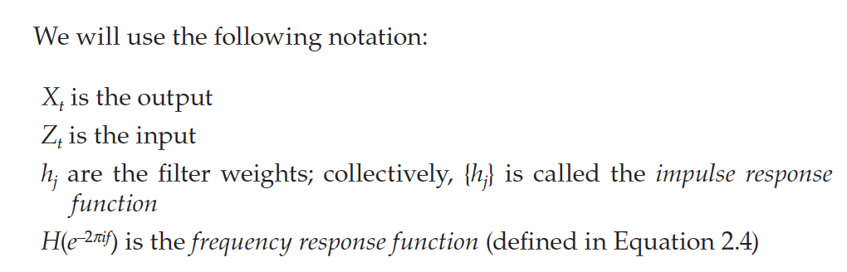
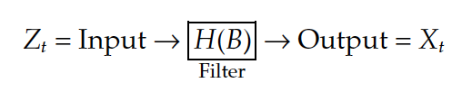
Linear Filters

Slide 3
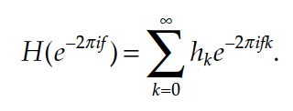
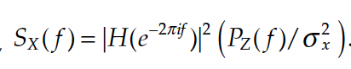
Spectral Density and Linear Filters
frequency response function
squared frequency response function

Slide 4
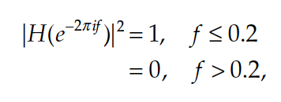
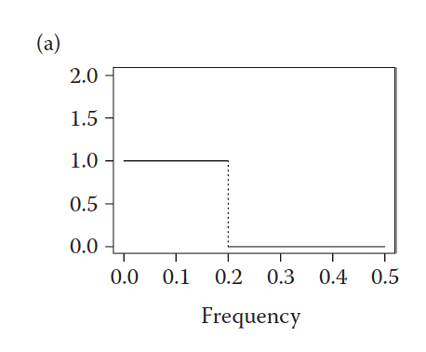
Ideal Frequency Response Function (Low Pass)

Slide 5
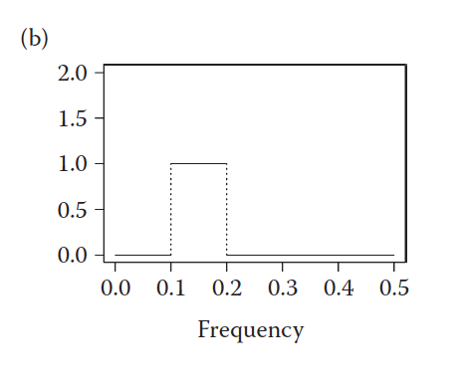
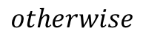
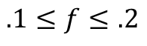
Ideal Frequency Response Function (Band Pass)
$$.1≤f≤.2$$
$$otherwise$$

Slide 6
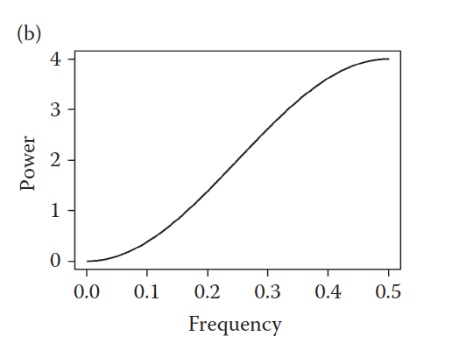
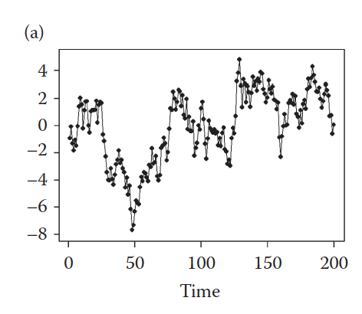
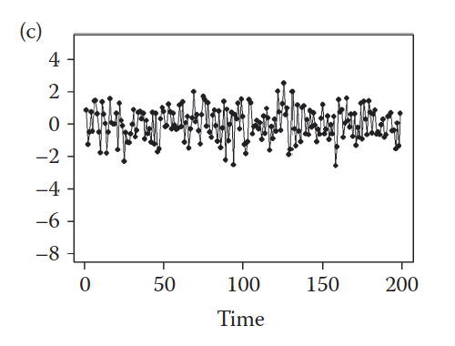
Frequency Response Function (High Pass) First Difference

Slide 7
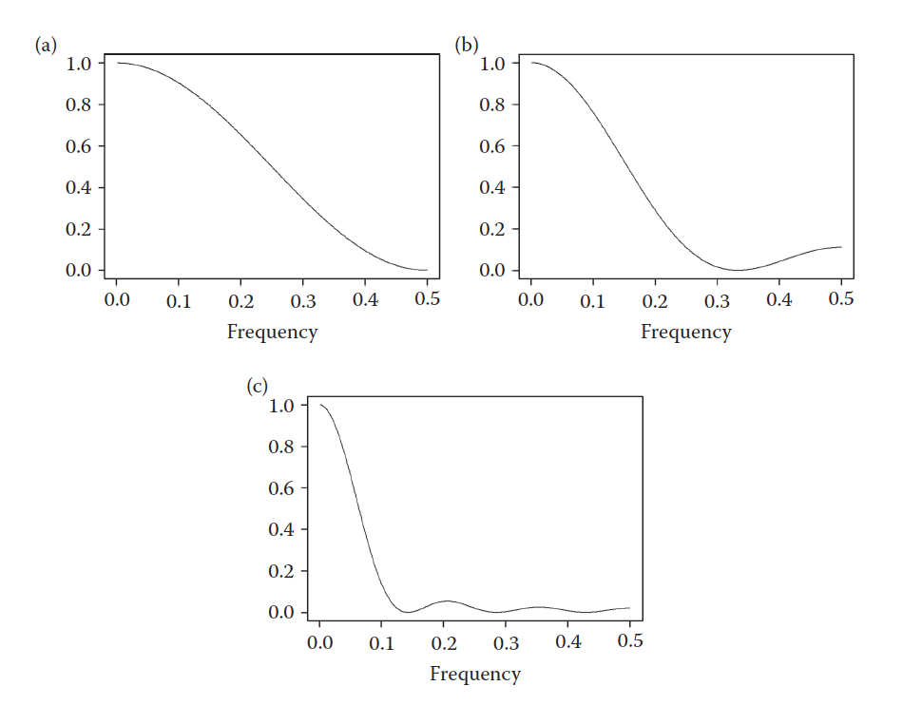
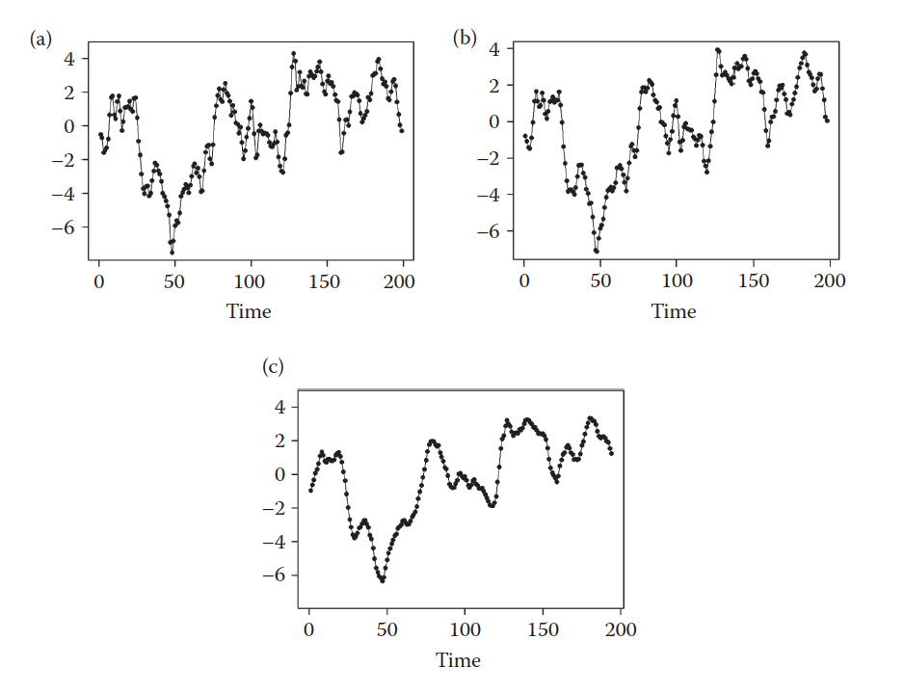
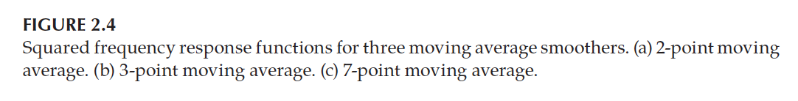
Frequency Response Function (Low Pass) Moving Average

Slide 8
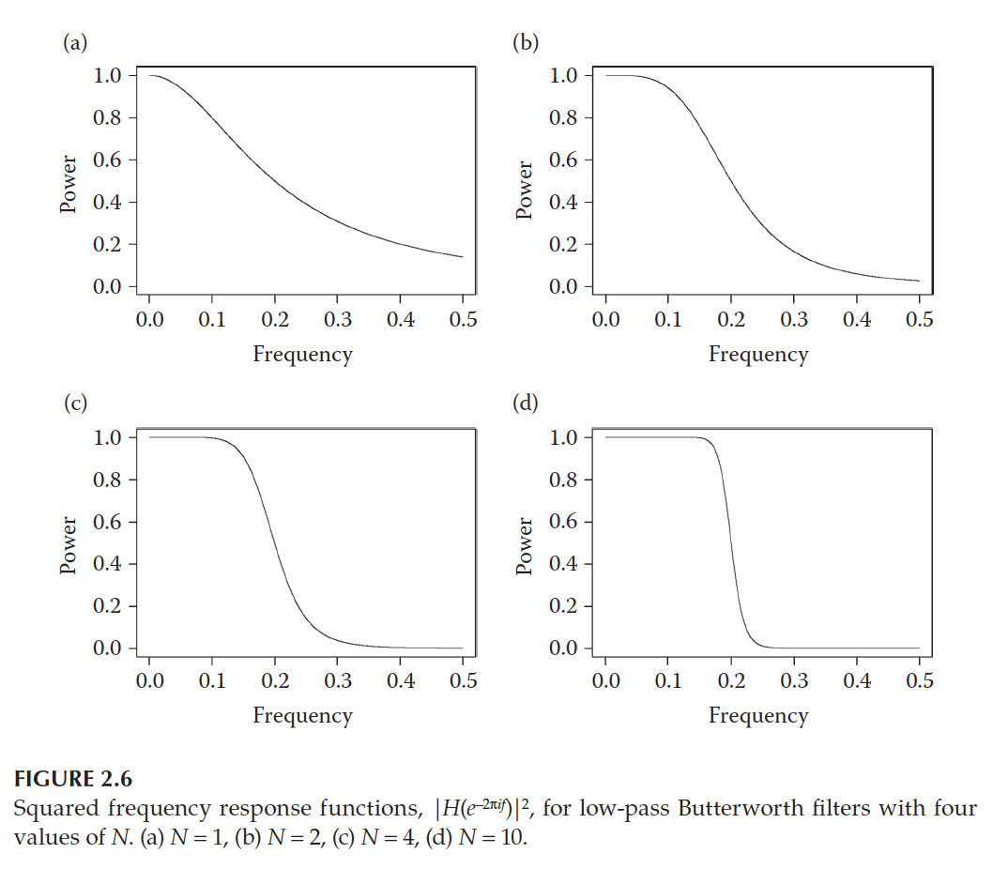
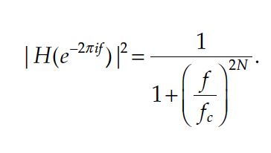
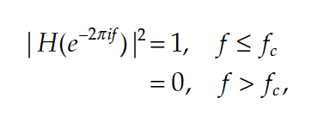
Butterworth Filters

Slide 9
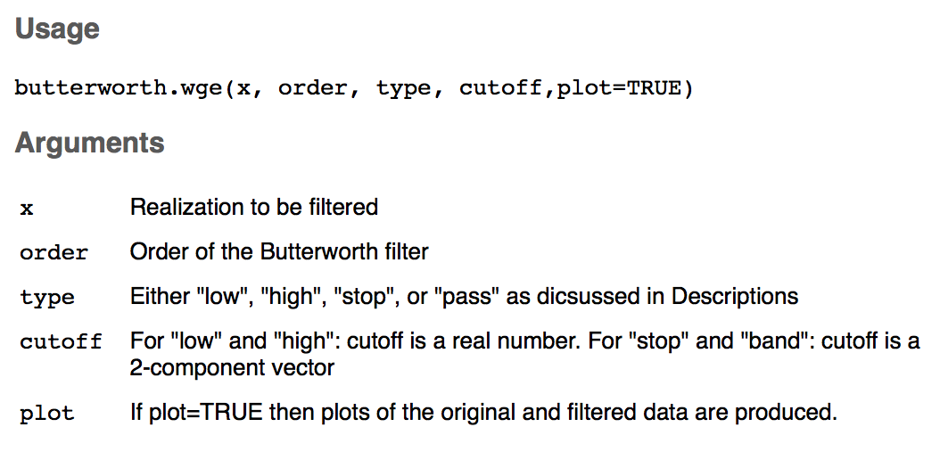
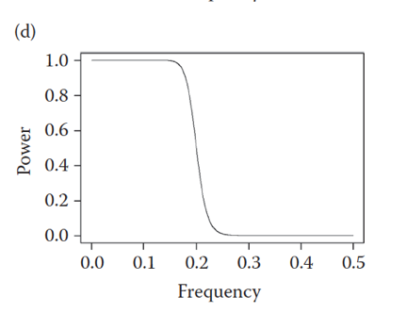
Butterworth Filter
butterworth.wge(x,order = 10, type = “low”, cutoff = .2)

Slide 10
BreakOut1
For Part 1 and Part 2
Plot the realization from each csv file.
Use Filters and other tools now at your disposal to try and diagnose the frequency or frequencies in the data.
Create a PowerPoint (Just one for the group.) for your reference and to possibly share with the class.

Slide 11
End Break Out 1

Slide 12
Break Out 2
Compare and check your answers for the worksheet. Make sure it all makes sense … we will be using these ideas extensively.
Move on to the two Questions (a-e for both).
If there is time… play with gen.arma.wge, plotts.sample.wge and plotts.true.wge

Slide 13
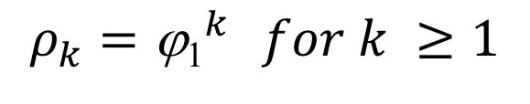

AR(1): X _{t} – φ ₁X_{t – 1} = a_{t}
Stationarity:
Stationary iff |$φ_{1}$| < 1
Autocorrelation:
$$ρ_{k}={\text{j}\text{1}}^{k} for k ≥1$$
damped exponential
(oscillating if ϕ₁ <0)
Realizations look like:
ϕ₁ > 0 : Wandering
ϕ₁ < 0 : Oscillating
Spectrum:
has a peak at f = 0 (ϕ₁ > 0) or f = .5 (ϕ₁ < 0)

Slide 14
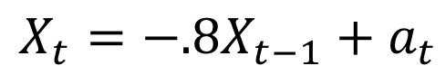
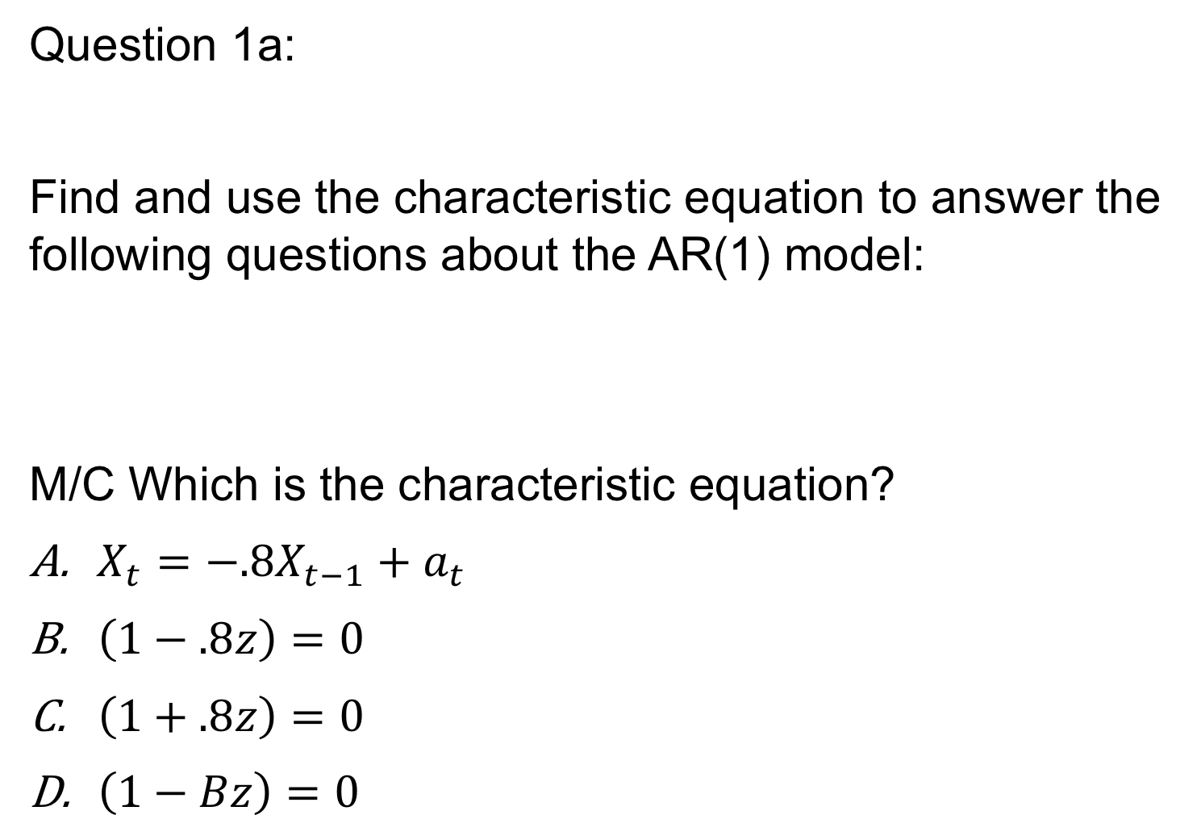
Question 1a:
Find and use the characteristic equation to answer the following questions about the AR(1) model:
M/C Which is the characteristic equation?
$X_{t}=−.8X_{t−1}+a_{t}$
$\left(1−.8z\right)=0$
$\left(1+.8z\right)=0$
$\left(1−Bz\right)=0$
$$X_{t}=−.8X_{t−1}+a_{t}$$

Slide 15
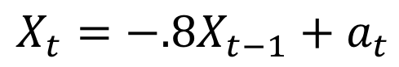
Question 1b:
Find and use the characteristic equation to answer the following questions about the AR(1) model:
What is the root of the equation. (Short Answer)
$$X_{t}=−.8X_{t−1}+a_{t}$$

Slide 16
Question 1c:
Find and use the characteristic equation to answer the following questions about the AR(1) model:
What is the inverse(absolute reciprocal) of the root: |r|⁻¹? (Short Answer).
$$X_{t}=−.8X_{t−1}+a_{t}$$

Slide 17
Question 1d:
Find and use the characteristic equation to answer the following questions about the AR(1) model:
M/C is a series generated by this model stationary?
$$X_{t}=−.8X_{t−1}+a_{t}$$

Slide 18
Question 1e:
Find and use the characteristic equation to answer the following questions about the AR(1) model:
Use tswge to create a realization from this model
$$X_{t}=−.8X_{t−1}+a_{t}$$

Slide 19
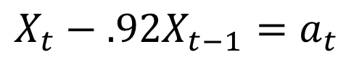
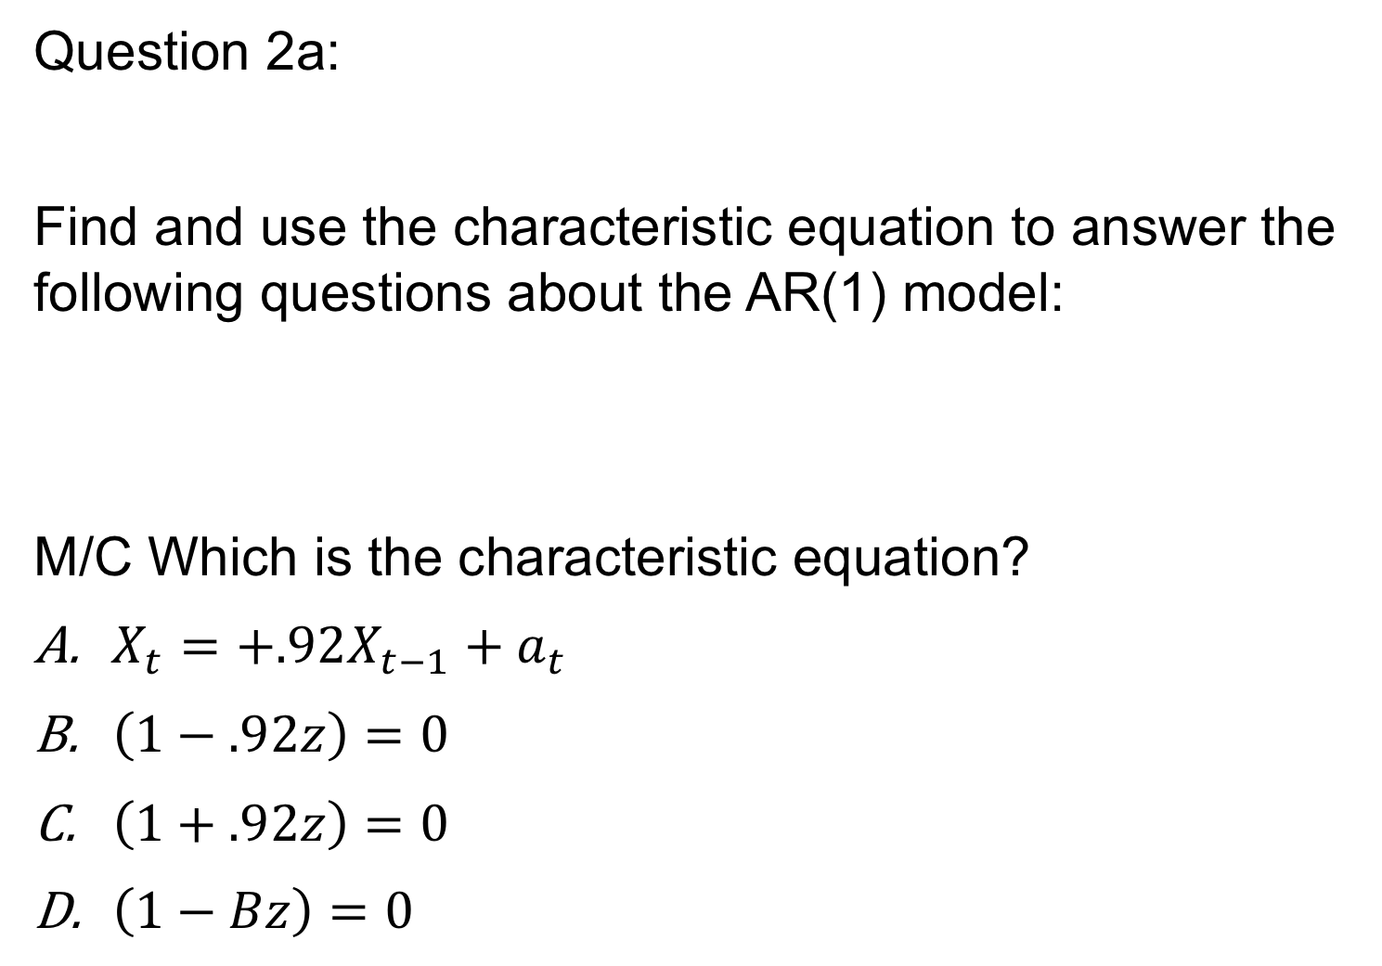
Question 2a:
Find and use the characteristic equation to answer the following questions about the AR(1) model:
M/C Which is the characteristic equation?
$X_{t}=+.92X_{t−1}+a_{t}$
$\left(1−.92z\right)=0$
$\left(1+.92z\right)=0$
$\left(1−Bz\right)=0$
$$X_{t}−.92X_{t−1}=a_{t}$$

Slide 20
Question 2b:
Find and use the characteristic equation to answer the following questions about the AR(1) model:
What is the root of the equation. (Short Answer)
$$X_{t}−.92X_{t−1}=a_{t}$$

Slide 21
Question 2c:
Find and use the characteristic equation to answer the following questions about the AR(1) model:
What is the inverse of the root: |r|⁻¹? (Short Answer).
$$X_{t}−.92X_{t−1}=a_{t}$$

Slide 22
Question 2d:
Find and use the characteristic equation to answer the following questions about the AR(1) model:
M/C is the series stationary?
$$X_{t}−.92X_{t−1}=a_{t}$$

Slide 23
Question 2e:
Find and use the characteristic equation to answer the following questions about the AR(1) model:
Use tswge to create a realization from this model
$$X_{t}−.92X_{t−1}=a_{t}$$

Slide 24
End Break Out 2

Slide 25
Break Out 3

Slide 26
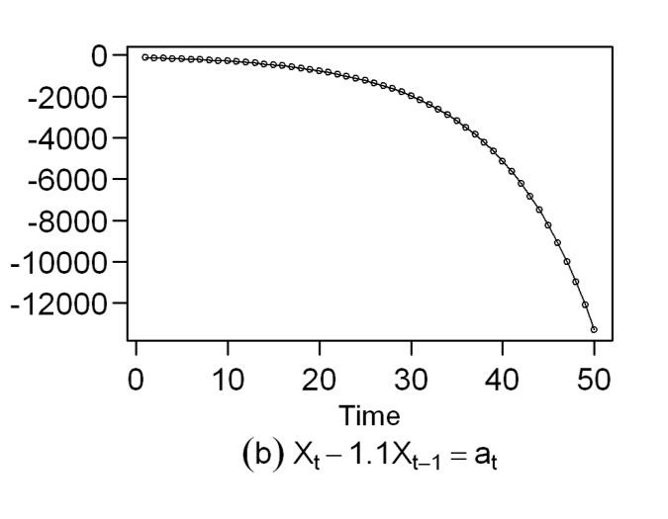
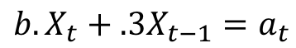
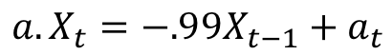
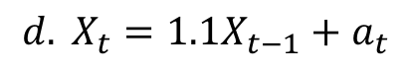
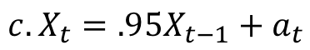
AR(1) Matching
1.
5.
Match the model with the realization and/or
ACF and/or Spectral Density
2.
6.
$${a. X}_{t}=−.99X_{t−1}+a_{t}$$
3.
7.
$${b. X}_{t}+.3X_{t−1}=a_{t}$$
$${c. X}_{t}=.95X_{t−1}+a_{t}$$
4.
8.
$${d. X}_{t}=1.1X_{t−1}+a_{t}$$

Slide 27
End Breakout 3

Slide 28
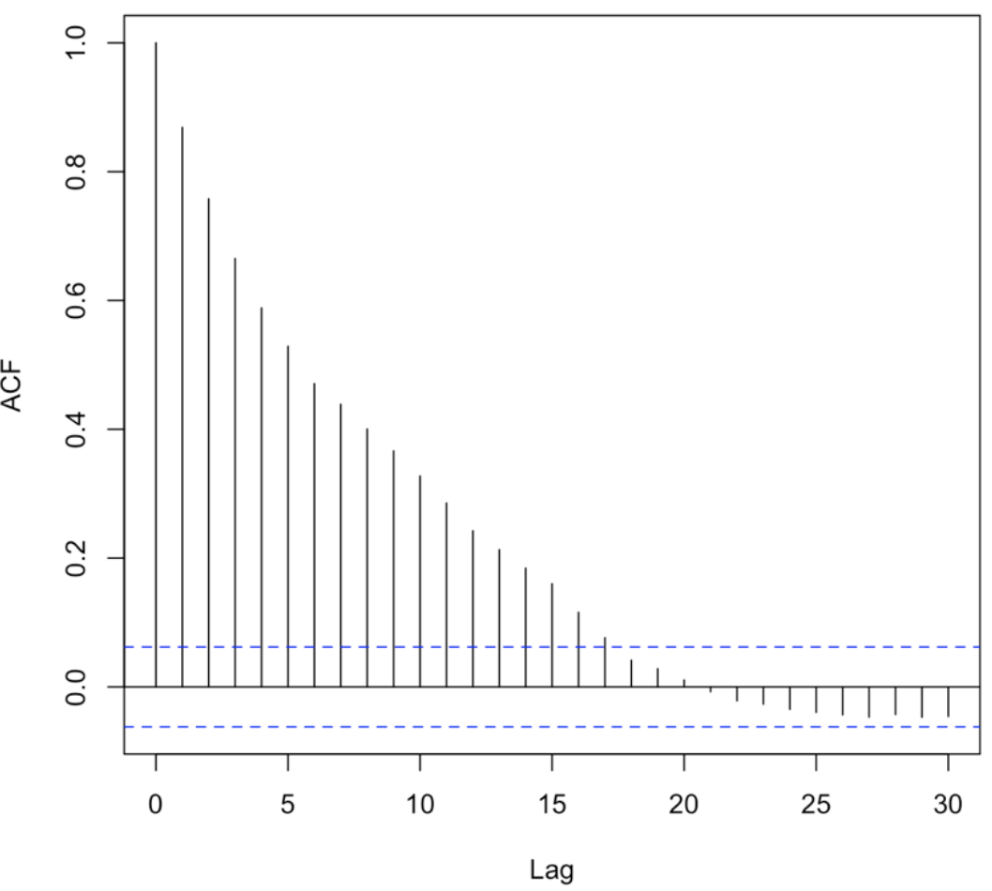
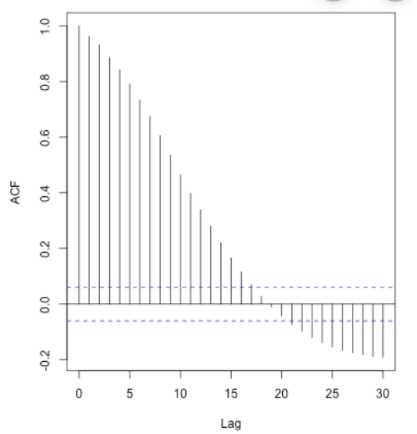
For Live Session Question(s)
For an AR(1) model, it said the autocorrelation exponentially approaches to 0; what does the increase in negative values (as shown in below ACF plots) after passing the 0 line tell us about the data? Does this tell anything else other than the negative correlation between the current and the previous lags?
Would you still consider them as AR(1) models?
acf(gen.arma.wge(100,phi = .95, sn = 6), lag.max = 20) acf(gen.arma.wge(5000,phi = .95, sn = 6), lag.max = 20)

Slide 29
Discuss White Noise

